Slide 1
Module III

Slide 2
Topics To be Covered
Software Requirement Analysis, design and coding
Problem Analysis, Software Requirement and Specifications, Behavioral and non- behavioral requirements, Software Prototyping Cohesion & Coupling, Classification of Cohesiveness & Coupling, Function Oriented Design, Object Oriented Design, User Interface Design Top-down and bottom-up Structured
programming, Information hiding

Slide 3
What is Requirement?
A software requirement is a capability needed by the user to achieve an objective.
According to IEEE standard 729, a requirement is defined as follows:
  A condition or capability needed by a user to solve a problem or achieve an objective
  A condition or capability that must be met or possessed by a system or system component to satisfy a contract, standard, specification or other formally imposed documents
  A documented representation of a condition or capability, as in 1 and 2.
This common understanding is vital to prevent any misunderstanding in the outcome
Thus, it behooves that we need ways to accurately capture, interpret, and represent the needs of our business partners/customers when specifying the requirements for a software product.

Slide 4
Software Requirement Analysis
All plan-driven life cycle models prescribe that before starting to develop a software, the exact requirements of the customer must be understood and documented.
Starting development work without properly understanding and documenting the requirements increases the number of iterative changes in the later life cycle phases, and thereby alarmingly pushes up the development costs.
A good requirements document not only helps to form a clear understanding of various features required from the software, but also serves as the basis for various activities carried out during later life cycle phases.

Slide 5
Overview of requirements analysis and specification
The requirements analysis and specification phase starts after the feasibility study stage is complete and the project is financially viable and technically feasible.
The requirements analysis and specification phase ends when the requirements specification document has been developed and reviewed.
The requirements specification document is usually called the software requirements specification (SRS) document.
The goal of the requirements analysis and specification phase is to clearly understand the customer requirements and to systematically organize the requirements into a document called the Software Requirements Specification (SRS) document.
Who performs requirements analysis?
Requirements analysis and specification activity is usually carried out by a few experienced members of the development team.
It normally requires them to spend some time at the customer site.
The engineers who gather and analyse customer requirements and then write the requirements specification document are known as system analysts.

Slide 6
Software Requirement Analysis phases
Elicitation: Gathering requirements from stakeholders (users, clients) using interviews, workshops, and surveys.
Problem Analysis & Negotiation: Identifying inconsistencies, ambiguities, and conflicts in requirements to refine them.
Specification : Creating the software requirement specification (SRS), which acts as a blueprint for design, documenting functional (what the system does) and non-functional (system properties) requirements.
Review :
After developing the SRS, it must be reviewed to check whether it can be improved or not and must be refined to make it better and increase the quality.

Slide 7
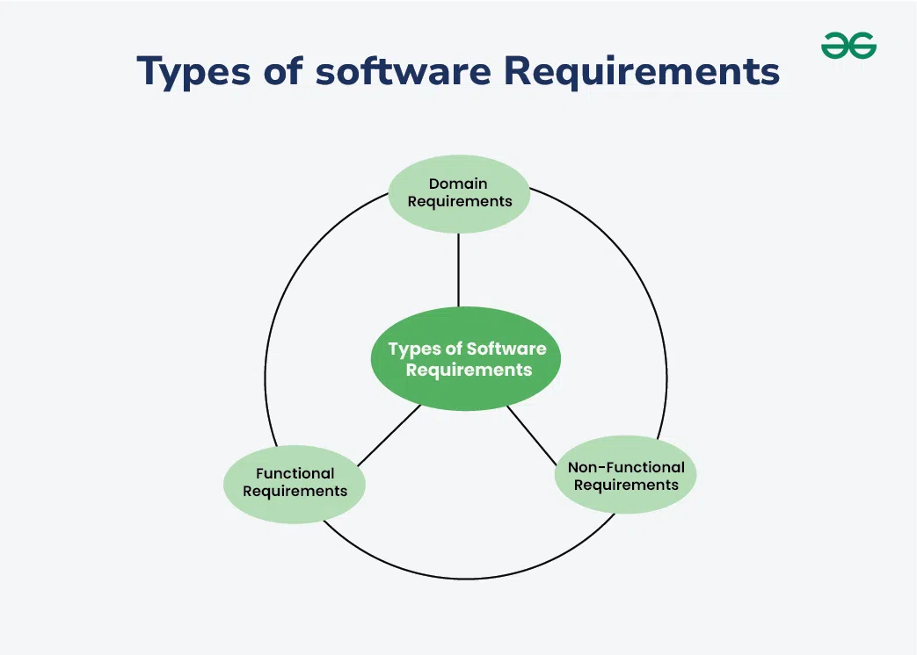

Slide 8
Behavioral (Functional) Requirements
Definition: Functional requirements describe what the software should do. They define the functions or features that the system must have.
Examples:
User Authentication: The system must allow users to log in using a username and password.
Search Functionality: The software should enable users to search for products by name or category.
Report Generation: The system should be able to generate sales reports for a specified date range.
Explanation: Functional requirements specify the actions that the software needs to perform. These are the basic features and functionalities that users expect from the software.

Slide 9
Cont.
Functional Requirements are the requirements that the end user specifically demands as basic facilities that the system should offer. It can be a calculation, data manipulation, business process, user interaction, or any other specific functionality that defines what function a system is likely to perform. All these functionalities need to be necessarily incorporated into the system as a part of the contract. These are represented or stated in the form of input to be given to the system, the operation performed and the output expected.

Slide 10
Cont.
They are the requirements stated by the user which one can see directly in the final product, unlike the non-functional requirements. For example, in a hospital management system, a doctor should be able to retrieve the information of his patients.
Each high-level functional requirement may involve several interactions or dialogues between the system and the outside world.
To accurately describe the functional requirements, all scenarios must be enumerated.
There are many ways of expressing functional requirements e.g., natural language, a structured or formatted language with no rigorous syntax, and formal specification language with proper syntax.
Functional Requirements in Software Engineering are also called Functional Specification

Slide 11
Non-Behavioral (Non-Functional) Requirements
Definition: Non-functional requirements describe how the software performs a task rather than what it should do. They define the quality attributes, performance criteria, and constraints.
Examples:
Performance: The system should process 1,000 transactions per second.
Usability: The software should be easy to use and have a user-friendly interface.
Reliability: The system must have 99.9% uptime.
Security: Data must be encrypted during transmission and storage.
Explanation: Non-functional requirements are about the system’s behavior, quality, and constraints. They ensure that the software meets certain standards of performance, usability, reliability, and security.

Slide 12
Cont.
These are basically the quality constraints that the system must satisfy according to the project contract. Nonfunctional requirements, not related to the system functionality, rather define how the system should perform The priority or extent to which these factors are implemented varies from one project to other. They are also called non-behavioral requirements. They basically deal with issues like:
Portability
Security
Maintainability
Reliability
Scalability
Performance
Reusability
Flexibility

Slide 13
Types of NF SR
Interface constraints
Performance constraints: response time, security, storage space, etc.
Operating constraints
Life cycle constraints: maintainability, portability, etc.
Economic constraints

Slide 14
Domain Requirements
Definition: Domain requirements are specific to the domain or industry in which the software operates. They include terminology, rules, and standards relevant to that particular domain.
Examples:
Healthcare: The software must comply with HIPAA regulations for handling patient data.
Finance: The system should adhere to GAAP standards for financial reporting.
E-commerce: The software should support various payment gateways like PayPal, Stripe, and credit cards.
Explanation: Domain requirements reflect the unique needs and constraints of a particular industry. They ensure that the software is relevant and compliant with industry-specific regulations and standards.

Slide 15
Cont.
Domain requirements are the requirements that are characteristic of a particular category or domain of projects. Domain requirements can be functional or nonfunctional. Domain requirements engineering is a continuous process of proactively defining the requirements for all foreseeable applications to be developed in the software product line. The basic functions that a system of a specific domain must necessarily exhibit come under this category. For instance, in academic software that maintains records of a school or college, the functionality of being able to access the list of faculty and list of students of each grade is a domain requirement. These requirements are therefore identified from that domain model and are not user-specific.

Slide 16
Software Prototyping
It is the process of implementing the presumed software requirements with an intention to learn more about the actual requirements or alternative design that satisfies the actual set of requirements .
Need for software prototyping
  To assess the set of requirements that makes a product successful in the market
  To test the feasibility without building the whole system.
  To make end-user involved in the design phase

Slide 17
Benefits of Software Prototyping
It makes the developers clear about the missing requirements. Let the developers know what the users actually want.
Reduces the loss by bringing the manufacturer to a conclusion whether the system that we are about to build is feasible or not, rather than building the whole system and finding out.
One can have a working system beforehand.
It brings the user to get involved in the system design

Slide 18
Coupling and Cohesion
Coupling and Cohesion are two key concepts in software engineering that are used to measure the quality of a software system’s design.
Both coupling and cohesion are important factors in determining the maintainability, scalability, and reliability of a software system.
High coupling and low cohesion can make a system difficult to change and test, while low coupling and high cohesion make a system easier to maintain and improve.

Slide 19
Cohesion
Cohesion refers to the degree to which elements within a module work together to fulfil a single, well-defined purpose. High cohesion means that elements are closely related and focused on a single purpose, while low cohesion means that elements are loosely related and serve multiple purposes.

Slide 20
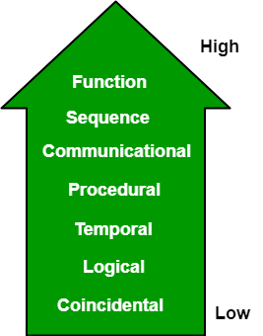
Types Of Cohesion
Functional Cohesion
Procedural Cohesion
Temporal Cohesion:
Sequential Cohesion.
Layer Cohesion.
Communication Cohesion.

Slide 21
Cont.
Sequential Cohesion: Elements are arranged so that the output of one part serves as the input to the next, often representing a data flow.
Communicational Cohesion: Elements operate on the same input data or contribute to the same output data, such as a module that updates a record and prints it.
Procedural Cohesion: Elements are grouped because they must follow a specific sequence of steps, though the steps might not be tightly connected.
Temporal Cohesion (Lower): Elements are grouped because they are processed at the same time, such as in an initialisation module or a closing module.
Layer Cohesion: Related to architectural layers, grouping modules that provide similar functional services (e.g., UI layer, data layer).
Higher cohesion (Functional/Sequential) reduces coupling and improves maintainability, whereas lower cohesion (Temporal/Procedural) makes code harder to maintain and reuse.

Slide 22
Coupling
Coupling refers to the degree of interdependence between software modules. High coupling means that modules are closely connected and changes in one module may affect other modules. Low coupling means that modules are independent, and changes in one module have little impact on other modules.

Slide 23
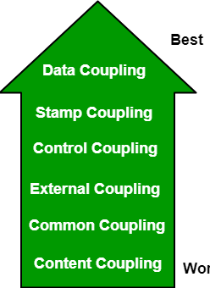
Types
Data Coupling
Stamp Coupling
Control Coupling
External Coupling
Common Coupling
Content Coupling

Slide 24
Cont.
Data Coupling (Weakest): Modules communicate by passing only necessary elementary data (e.g., passing an integer or boolean) as parameters.
Stamp Coupling: Modules pass a complete data structure (e.g., a record, object, or struct), but the receiving module only uses a part of it.
External Coupling: Modules depend on external tools, protocols, files, or devices. A change in the external format forces a module change.
Control Coupling: One module passes control information (a flag) to another, influencing its logic flow (e.g., a "what-to-do" flag).
Common Coupling: Multiple modules read and write to the same global data space or shared variable. This makes tracing data changes difficult.
Content Coupling (Strongest): One module modifies, jumps into, or refers to the internal code/data of another module directly (e.g., direct branch or data access).

Slide 25
Software Engineering Design
Software Design Process is the phase where developers plan how to turn a set of requirements into a working system. Like a blueprint for the software. Instead of going straight into writing code, developers break down complex requirements into smaller, manageable pieces, design the system architecture, and decide how everything will fit together and work.
Types :
Function-Oriented Design
Object-oriented Design

Slide 26
Function Oriented Design
Function-oriented design (FOD) is a software engineering approach that decomposes a system into smaller, interacting modules based on the actions or functions they perform. It uses a top-down approach to break down high-level requirements into sub-functions, often modelled using Data Flow Diagrams (DFDs) and Structured Charts.

Slide 27
Key characteristics and techniques include:
Functional Decomposition: Breaking down complex tasks into smaller, manageable functional modules (often called "verbs").
Transformation View: Treating the system as a transformation function that processes inputs to generate outputs.
Data Sharing: Modules often interact by passing data or using global memory.
Tools: Relies on Structure Charts, Data Flow Diagrams (DFDs), and Data Dictionaries to map the architecture.
Best Use Cases: Suitable for systems with stable, well-defined requirements where the process flow is more critical than data structures

Slide 28
Cont.
Advantages:
Simple and easy to understand.
Directly translates functional requirements into a modular structure.
Effective for smaller or process-centric projects.
YouTube
Limitations:
Lower reusability compared to object-oriented design.
Risk of high coupling if modules share too much data.
Harder to maintain when requirements change significantly.

Slide 29
DFD
A Data Flow Diagram (DFD) is a graphical tool used to represent how data moves through a system. It shows data inputs, outputs, data stores, and the processes that transform the data. DFDs provide a high-level overview of system functionality and are widely used in structured analysis due to their simplicity and clarity for both technical and non-technical users.

Slide 30
Levels of Data Flow Diagram
DFDs are categorized into various levels, with each level providing different degrees of detail. The levels are numbered from 0 and onward. The higher the level, the more detailed the diagram becomes
Level 0 DFD (Context Diagram): Represents the entire system as one single process, showing its interaction with external entities. It highlights major inputs and outputs without internal details.
Level 1 DFD: Breaks the Level 0 process into major subprocesses. Shows internal data flows and data stores.
Level 2 and Beyond: Further decomposes Level 1 subprocesses for a detailed view of specific functional areas. Useful for large or complex systems requiring deeper analysis.

Slide 31
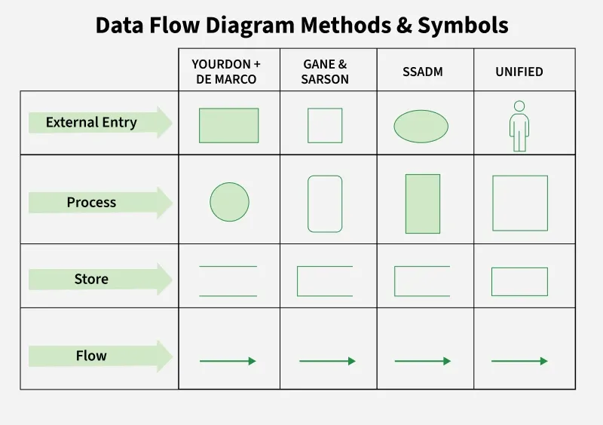

Slide 32
Rules of DFD
Following are the rules of DFD:
1. Data can flow from
Terminator or External Entity → Process
Process → Terminator or External Entity
Process → Data Store
Data Store → Process
Process → Process
2. Data Cannot Flow From
Terminator or External Entity → Terminator or External Entity
Terminator or External Entity → Data Store
Data Store → Terminator or External Entity
Data Store → Data Store

Slide 33
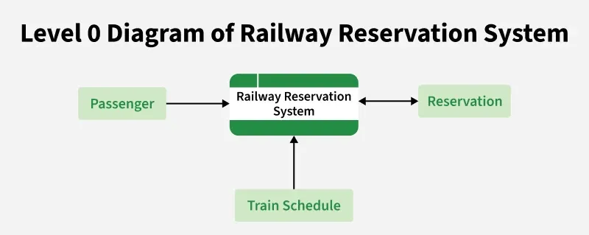
Levels of DFD (Railway Reservation System)
Shows the reservation system as one process interacting with:
Passenger (external entity)
Payment system
Database (data store)

Slide 34
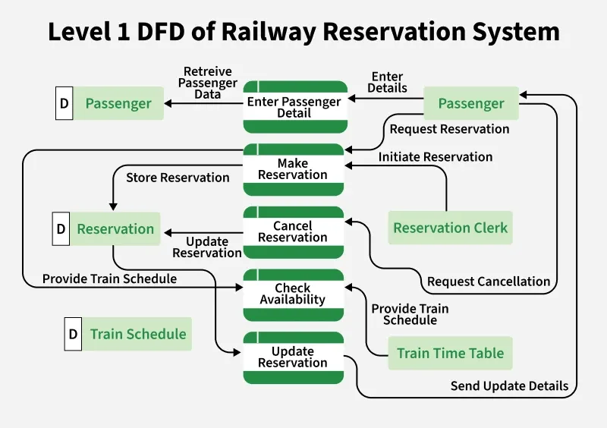
Breaks the system into subprocesses such as:
Search Train
Book Ticket
Cancel Ticket
Process Payment

Slide 35
Level 2 DFD
Further decomposes subprocesses (e.g., "Book Ticket" → Verify Availability → Calculate Fare → Confirm Booking)

Slide 36
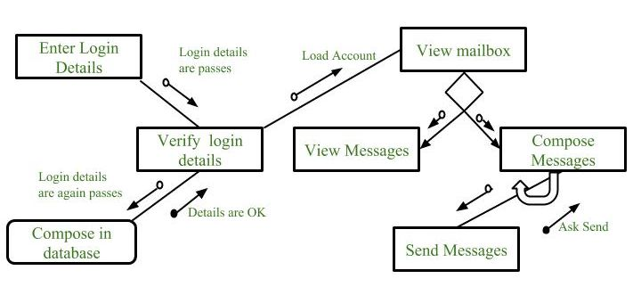
Structured Chart
A structure chart in software engineering is a top-down, hierarchical diagram used to visualize the architectural design of a system. It decomposes a program into smaller, manageable modules (represented by boxes) and shows their control relationships, interactions, and the data or control signals passed between them.

Slide 37
Key Aspects of Structure Charts:
Modules (Boxes): Represent subroutines, functions, or processes.
Connections (Lines): Show which modules call others, indicating the control hierarchy.
Data Couple (Arrow with empty circle): Indicates data passed between modules.
Control/Flag Couple (Arrow with filled circle): Indicates control signals (e.g., true/false flag) passed between modules.
Loops & Decisions: Specialized symbols indicate iterative or conditional execution of modules

Slide 38
Object-oriented Design
Object-Oriented Analysis and Design (OOAD) is a software design approach that models a system using real-world objects. It first focuses on understanding system requirements, then identifying objects and defining how they interact. OOAD is based on object-oriented programming principles and combines Object-Oriented Analysis (OOA) and Object-Oriented Design (OOD).
Example: In a library management system, objects like Book, Member, and Librarian are identified, each with its own data and behavior, and they interact to manage book borrowing and returns.

Slide 39
Cont.
Object-Oriented Programming: In this the real-world items are represented/mapped as software objects with attributes and methods that relate to their actions.
Design Patterns: Design patterns are used by OOAD to help developers in building software systems that are more efficient and maintainable.
UML Diagrams: UML diagrams are used in OOAD to represent the different components and interactions of a software system.
Use Cases: OOAD uses use cases to help developers understand the requirements of a system and to design software systems that meet those requirements.

Slide 40
The OOD Process
Requirement Analysis: Defining the system's intended functionality.
System Design: Creating a high-level structure, identifying objects, and defining their relationships and interfaces.
Modeling (UML): Using Unified Modeling Language (UML) diagrams (class diagrams, interaction diagrams) to visualize the design.
Implementation: Coding the objects using an object-oriented programming language.
Testing: Verifying that the objects interact correctly to meet requirements.

Slide 41
User Interface (UI) Design
UI Design is the process of creating the front-end interaction, focusing on making interfaces intuitive, accessible, and user-centric.
Core Principles:
User-centered: Understanding user needs, tasks, and context.
Consistency: Using uniform UI elements (colors, icons, fonts) to reduce learning curves.
Feedback: Providing clear, immediate responses to user actions.
Simplicity & Flexibility: Creating intuitive layouts that allow user customization.
Process: User analysis -> Prototyping -> Design -> Evaluation

Slide 42
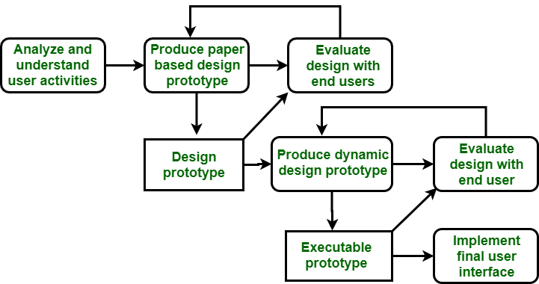
Characteristics of Good User Interface in Software Engineering

Slide 43
Top-down and bottom-up Structured programming
Top-down programming (structured) decomposes a large system into smaller, manageable modules starting from the top, while bottom-up builds from small, tested components upwards. Information hiding, a key principle of modularity and object-oriented design, conceals internal implementation details of modules behind a strict interface to reduce complexity and dependency

Slide 44
Bottom-Up Structured Programming (Composition Approach)
Process: Starts by building small, fundamental components or modules, testing them, and then combining them into larger subsystems, eventually creating the complete system.
Characteristics: Widely used in Object-Oriented Programming (OOP) (e.g., C++, Java, Python).
Advantages: Promotes code reusability; easier to test individual components; less redundancy.
Drawbacks: Difficult to visualize the overall, integrated system until the very end.

Slide 45
Top-Down Structured Programming (Decomposition Approach)
Process: Begins by designing the high-level overview of the program, then progressively breaks it down into smaller, functional modules or sub-programs.
Characteristics: Primarily used in structured programming languages (e.g., C, COBOL, Fortran).
Advantages: Ideal for large systems where the high-level architecture is defined early; easier to identify errors in overall design.
Drawbacks: Subprograms may be challenging to test in isolation; higher possibility of redundant information.

Slide 46
Difference
S. No. | TOP DOWN APPROACH | BOTTOM UP APPROACH
1. | focus on breaking the problem into smaller, more manageable parts | Solves smaller problems and integrates them into a complete system
2. | Mainly used in Structured programming languages like COBOL, Fortran, C, etc. | Mainly used in Object Oriented Programming languages like C++, C#, Python.
3. | Each part is programmed separately therefore contains redundancy. | Redundancy is minimized by using data encapsulation and data hiding.
4. | communication is less among modules. | Modules must communicate to integrate the system.
5. | It is used for debugging and module documentation | It is basically used in testing.

Slide 47
Information Hiding
Concept: A design principle where modules hide their inner workings (implementation details) and only expose essential functions through a defined interface.
Purpose: Minimizes complexity and reduces dependency between different modules. If one module is changed, the impact on others is minimized.
Application: Crucial in both structured programming (functional decomposition) and object-oriented programming (encapsulation).

